Slide 1

Energy Consumption Forecasting Model
Serge Nane | Daniel Meier | Joseph Choi | Jenny Albrecht
DSC450 Applied Data Science
Spring 2024

Slide 2
AGENDA
INTRODUCTION
Overview
Problem statement
Overview of data
Method (s) used
MODEL SUMMARY
DATA VISUALIZATION
Feature importance and Correlation matrix
Model performance
CONCLUSION

Slide 3
INTRODUCTION

Slide 4
OVERVIEW
Energy sustainability is crucial for our planet's health and the quality of life of future generations.
Reducing home energy usage is an essential step towards a more sustainable future.
Our project uses data analysis and data science to address energy conservation.

Slide 5
PROBLEM STATEMENT
The project aims to answer two key research questions:
What are the main factors influencing energy consumption?
Can we predict future energy consumption in buildings using historical data?

Slide 6
OVERVIEW OF DATA
Description: Simulated historical energy consumption data, with variables influencing energy usage.
Dataset Location: Available on Kaggle Energy-consumption-prediction (kaggle.com)
Data Field: Timestamp, Temperature, Humidity, Square Footage, Occupancy, HVAC Usage, Lighting Usage, Renewable Energy, Day Of Week, Holiday and Energy Consumption

Slide 7
METHOD(S) USED
Approach Overview:
Our strategy leverages machine learning to gain insights into energy efficiency and sustainability from historical data analysis. This includes data visualization for trend identification and algorithm exploration for predictive performance evaluation.
Phase:
Data Cleaning
Data Transformation
Exploratory Data Analysis (EDA)
Feature Engineering
Data Modeling

Slide 8
MODEL SUMMARY

Slide 9
Performance Summary:
Random Forest Model: Achieved moderate accuracy, best R2 Score at 0.6023. Performance varied with feature selection and tuning.
Linear Regression Model: More consistent and higher predictive accuracy, best R2 Score at 0.6480 with a specific feature combination.
Key Predictors:
Temperature (Temp_F) and HVAC usage emerged as critical factors influencing energy consumption across both models.
Assessment of Accuracy:
R2 Scores (0.60 - 0.65 range) indicate reasonable accuracy but not precision. Models can predict trends but may not fully capture dataset complexities.
Insights and Implications:
The improvement in the Linear Regression model with feature optimization suggests a more linear relationship in the data.
The Random Forest model's varied performance indicates potential non-linear interactions in the data.
Random Forest Model Iterations:
We conducted seven iterations, varying feature selection and model parameters.
Initial model (all features, 80/20 split): R2 Score = 0.5417.
Adjusted to 90/10 split: R2 Score = 0.5799.
Hyper-tuned parameters: R2 Score = 0.6023.
Removed two lowest features (AM/PM, Holiday), re-ran: R2 Score = 0.5974.
Hyper-tuned with updated features: R2 Score = 0.5878.
Top 3 features only (Temp_F, HVAC Usage, Renewable Energy), base parameters: R2 Score = 0.5370.
Hyper-tuned with top 3 features: R2 Score = 0.5612.
Linear Regression Model Iterations:
Conducted five iterations with various feature combinations.
Initial model (all features, 80/20 split): R2 Score = 0.5987.
Adjusted to 90/10 split: R2 Score = 0.6224.
Removed bottom two features: R2 Score = 0.6261.
Top 3 features only: R2 Score = 0.5693.
Best 4-feature combination (Temp_F, HVAC Usage, Occupancy, Lighting Usage): R2 Score = 0.6480.

Slide 10
DATA VISUALIZATION

Slide 11
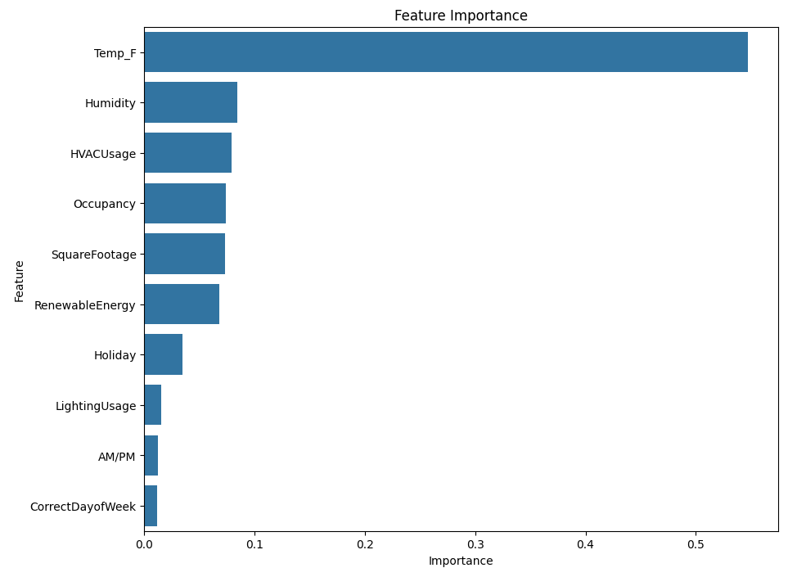
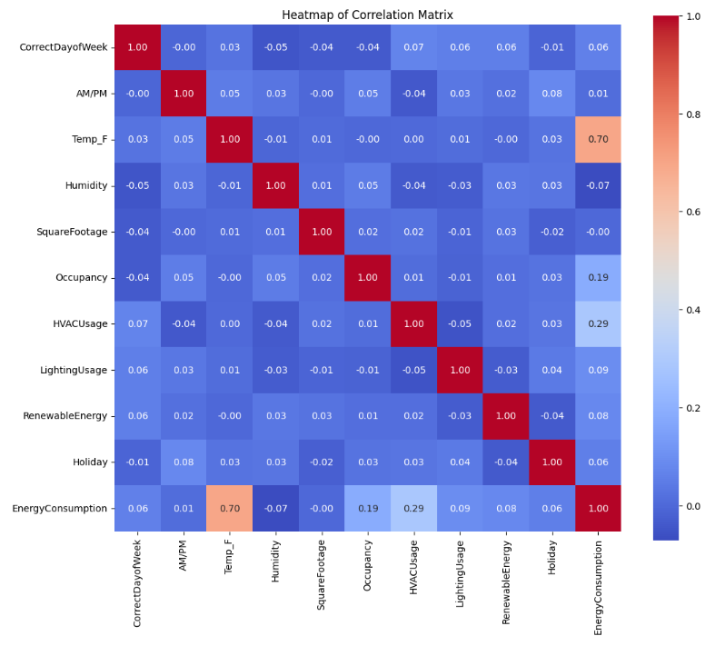
FEATURE IMPORTANCE & CORRELATION MATRIX

Slide 12
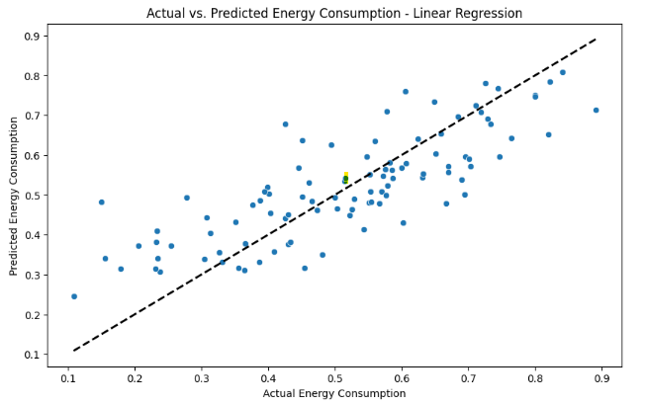
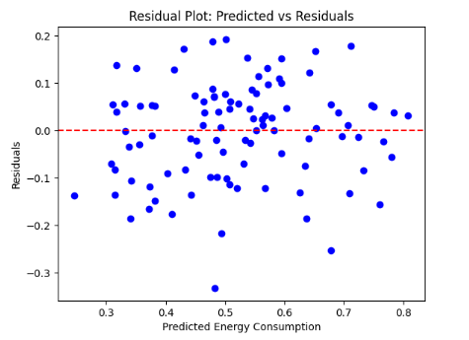
Model Performance

Slide 13
CONCLUSION

Slide 14
RECOMMENDATIONS AND NEXT STEPS
Recommendations:
Install programmable or smart thermostats/HVAC units
Utilize our energy consumption model as a predictive engine
Next Steps:
Conduct further analysis to identify additional relevant features
Perform more feature engineering
Experiment with different model types and hyperparameters

Slide 15
THANK YOU!

